Slide 1
Unnamed WIP Project
Albert Deniz Levi

Slide 2
What is it?
Honestly I have no idea.

Slide 3
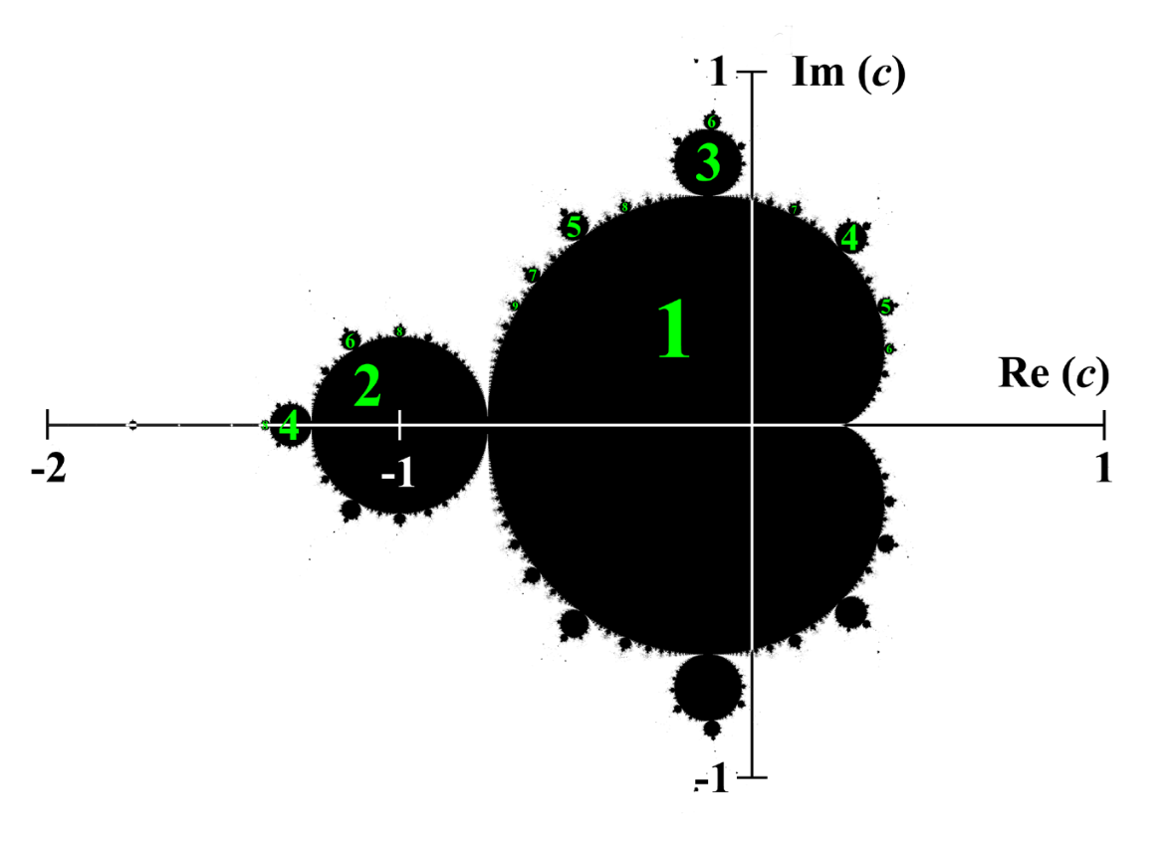
What is it about?
Mandelbrot set (specifically a super confusing variant)
Music?
Inventing a music instrument (which involves reading papers and other complicated stuff)
Maybe a website

Slide 4


Slide 5


Slide 6
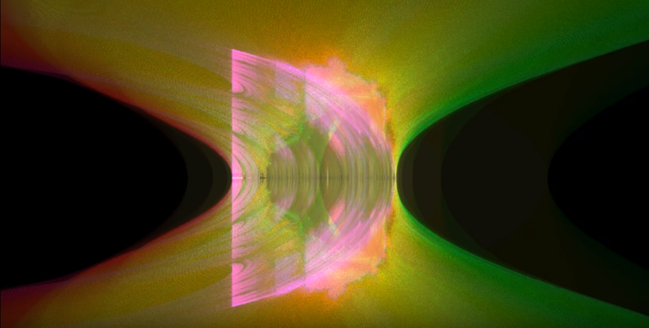

Slide 7
n = 100; Julibrot[z0_, zc_] := Module[{z = z0, i = 0}, While[i <12 && Abs[z] < 2, z = z^2 + zc; i++]; i]; image = Table[z = 1.5; While[z >= 0 && Julibrot[z, x + I y] < 12, z -= 3/n]; z, {y, -1.5, 1.5, 3/n}, {x, -2, 1, 3/n}];
ListDensityPlot[image, Mesh -> False, Frame -> False,PlotRange -> {0, 1.5}]

Slide 8
https://www.desmos.com/calculator/hvfvsmj6vs

Slide 9
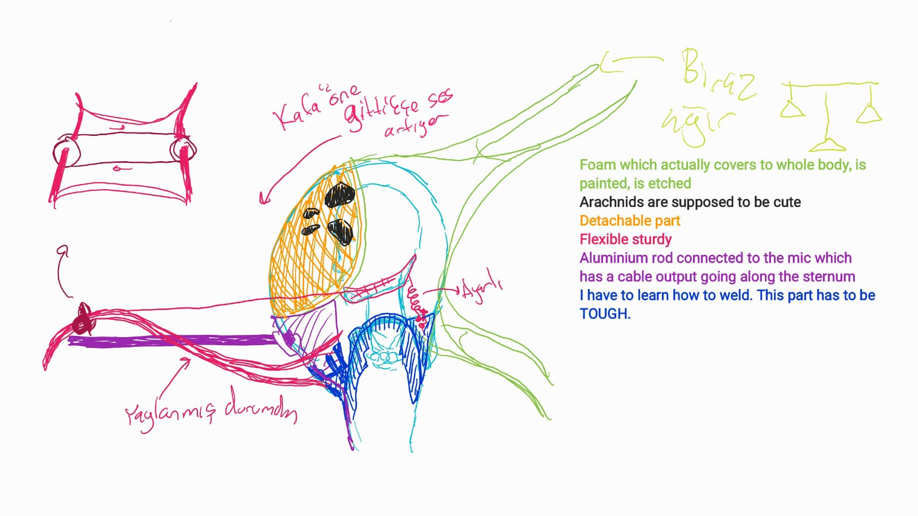

Slide 10
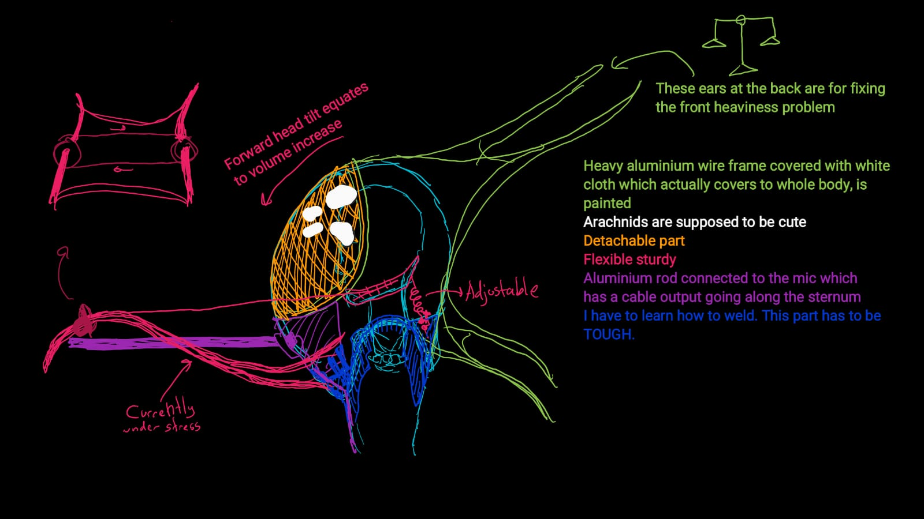

Slide 11
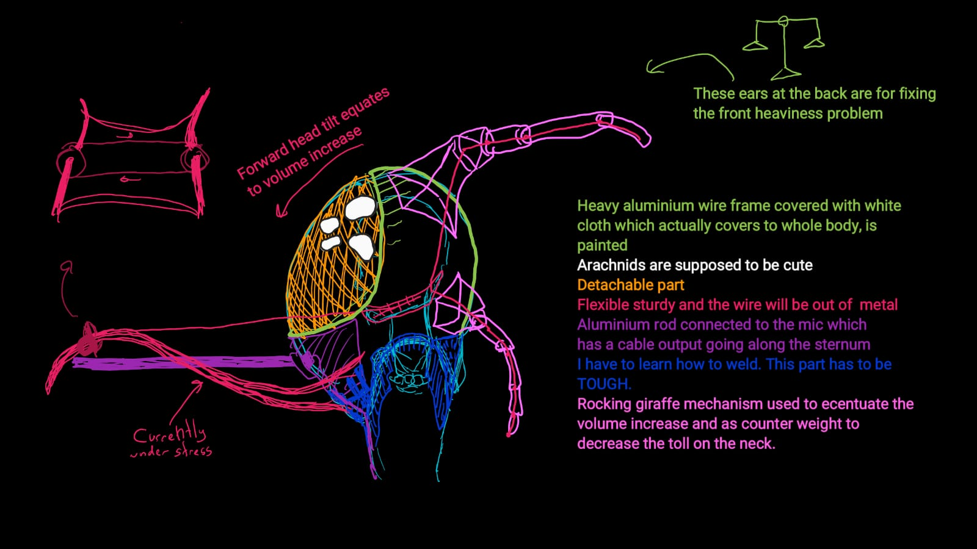

Slide 12
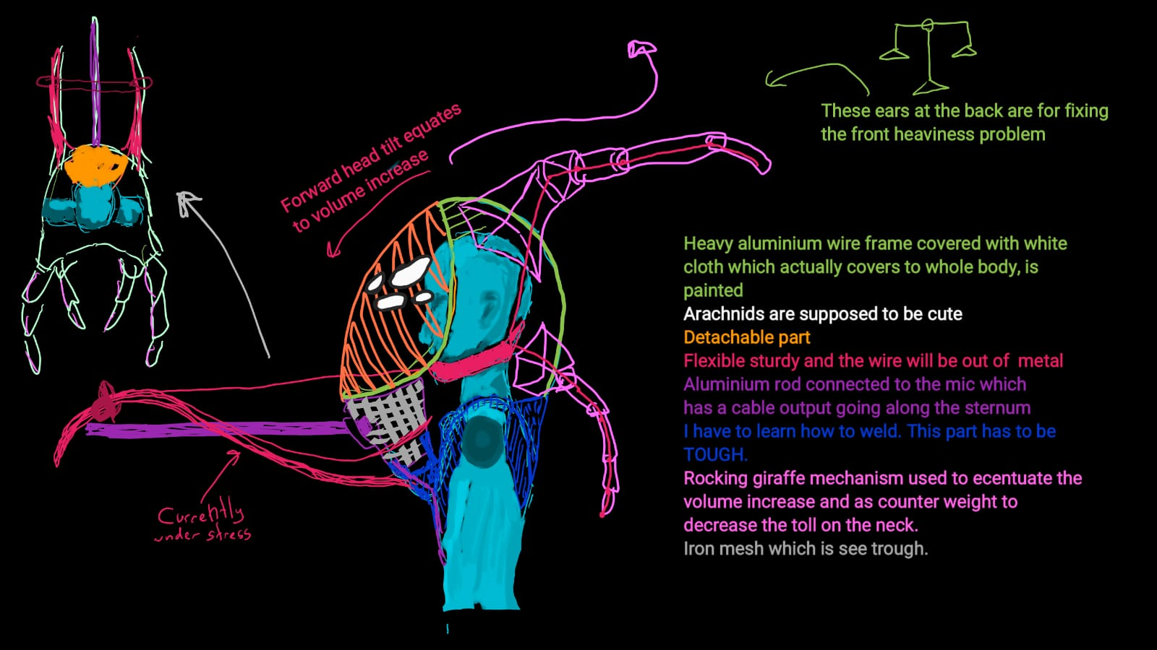

Slide 13
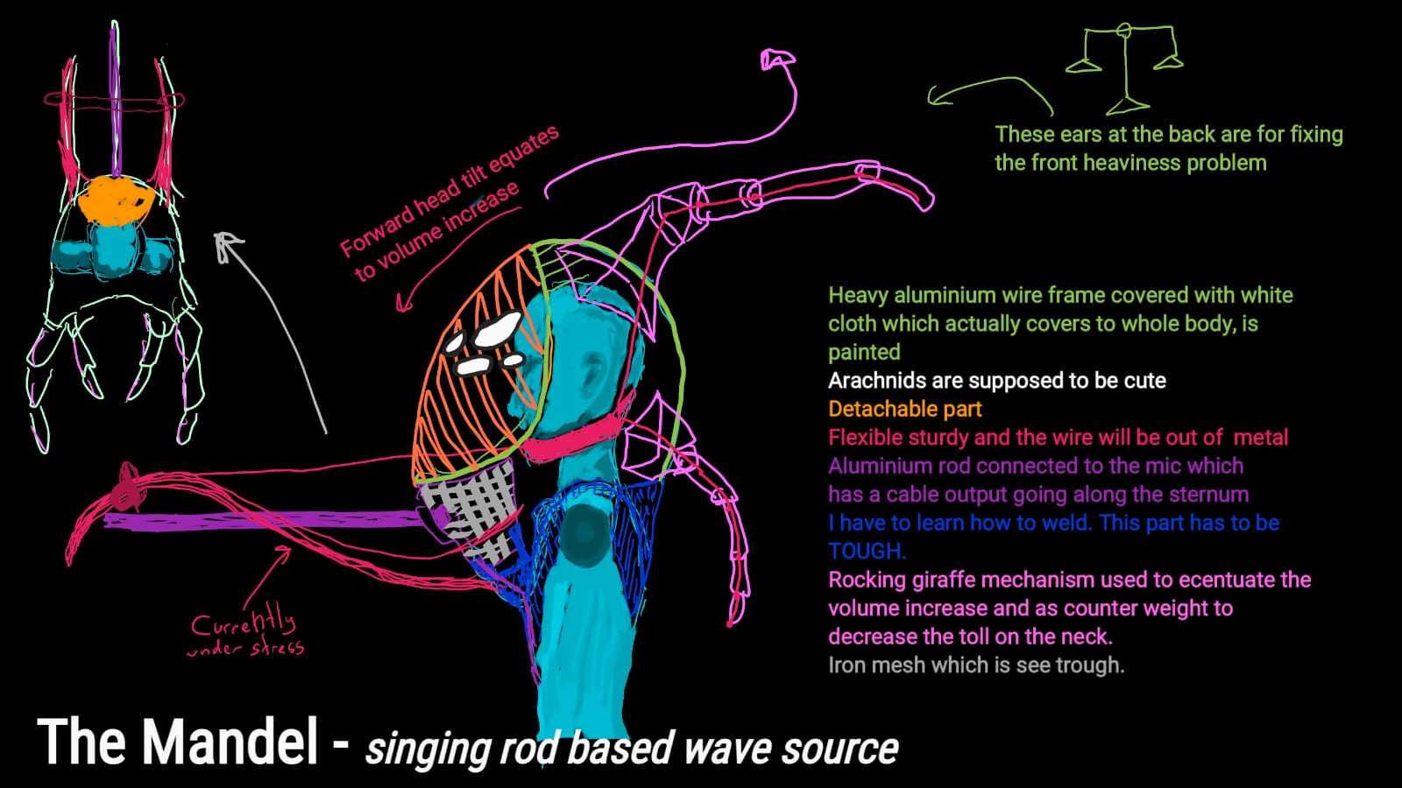

Slide 14
